Slide 1
Cafe Business Opportunities in Finland?
Study report

Slide 2
How do Finnish cities appear to someone willing to start a new café in Finland?
This is a report of a study that answers the title question
Read this to find out in more detail
Characteristics of Finnish cities
Café related factors in Finland
Who should care:
Anyone with an entrepreneurial spirit and café business creation intentions

Slide 3
Data
This study and results are based on two major, freely available datasets
Paavo dataset:
statistical data on postal code area level (inhabitants ages, education, income, jobs, households etc)
Published by Statistics Finland
3026 postal code areas in Finland, 105 variables (in 8 groups) of information on each postal code area
Venue dataset:
Venue location and category information
Available from Foursquare service
17 702 distinct venues in Finland, in 461 unique venue categories

Slide 4
Process
Data was gathered, confirmed, merged together and turned around multiple times
Machine learning methods like clustering (find common characteristics of postal code areas) and linear regression (propose potential areas to check out for new café businesses)
Statistical analysis: what things relate to the amounts of cafes in certain areas in Finland
Summaries: how do cities compare to each other as environments

Slide 5
Results
Postal Code Area analysis (this will build up to understanding the cities)
Top 20 cities in Finland – Via numbers
Correlations of Café amounts and other data features (like inhabitant age)
Predictions

Slide 6
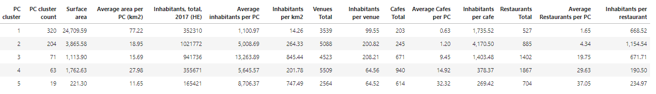
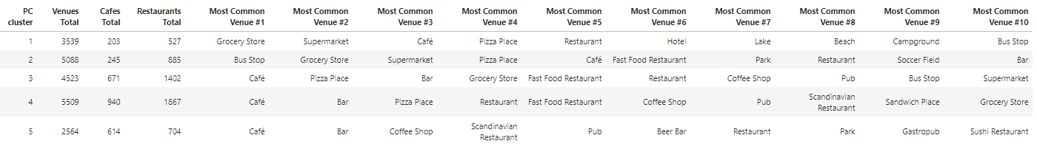
Results: Postal Code Areas in 5 groups

Slide 7
Results: Analysis of Postal Code Areas
On previous data:
Cluster 1 presents postal code areas, which are on average quite large (surface area), and small in population. They do not offer much café nor restaurant services compared to the population. Most common venues are about shopping, and the top 10 includes even likes of lakes, beaches and camping areas. Altogether, this cluster represents somewhat rural areas…
Cluster 2 appears as a ‘sleeping’ neighborhood, typical around bigger cities (average population density, not many venues nor interesting venues…)

Slide 8
Results: Analysis of Postal Code Areas
On previous data, continued:
Cluster 5 presents on average quite small postal code areas (surface area), but they are among the most densely populated areas in Finland. There are a lot of venue offerings centered in these small areas, and the top 10 venue categories are about cafes, bars and restaurants. There even some fine specialty venue types in top 10: sushi restaurants, gastropubs, beer bars and scandinavian restaurants. Altogether, this cluster represents very urban context, active big city centers.
Clusters 3 and 4 represent central areas of midsized cities, 3 having most densely populated aread but 4 having a lot more venue offerings…

Slide 9
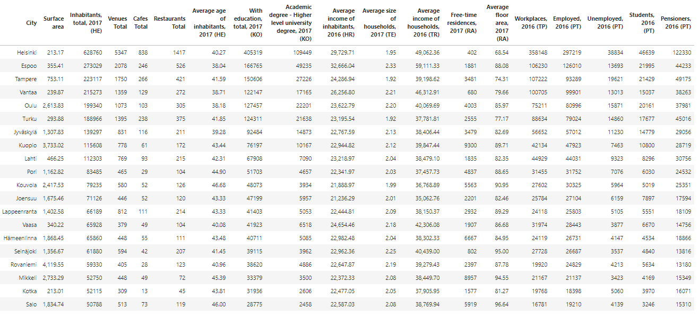
The numbers - Top 20 cities in Finland

Slide 10
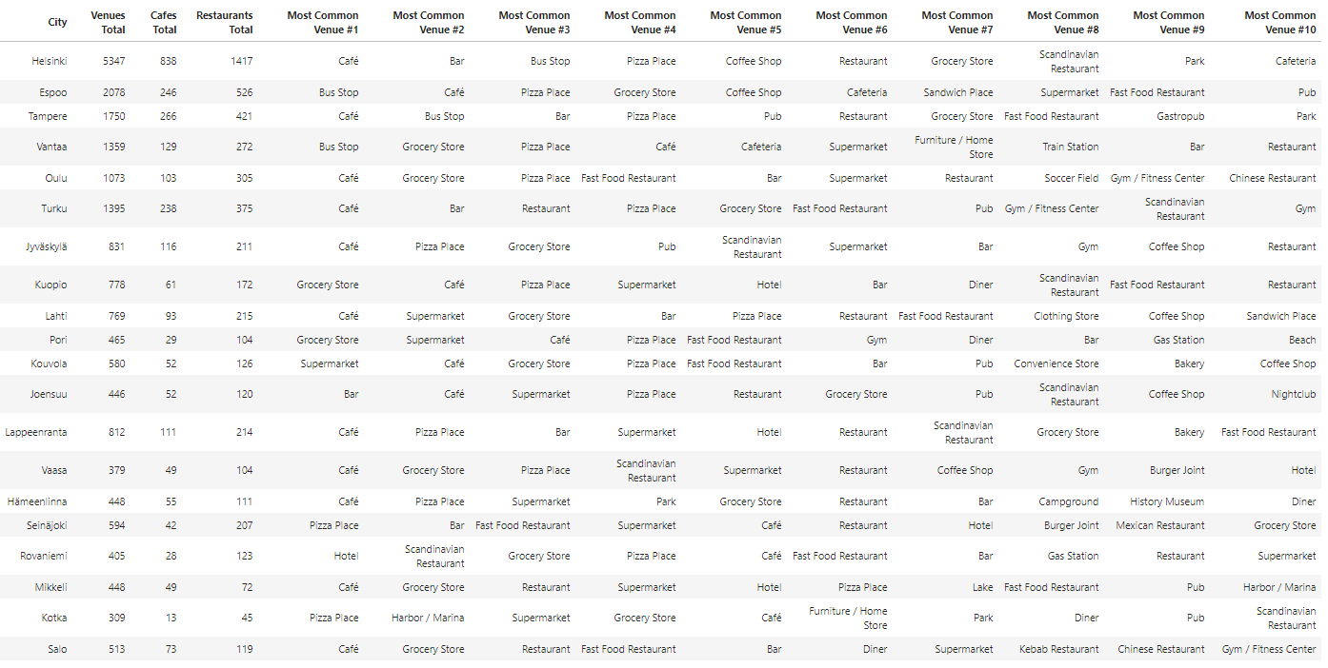
The numbers - Top 20 cities in Finland

Slide 11
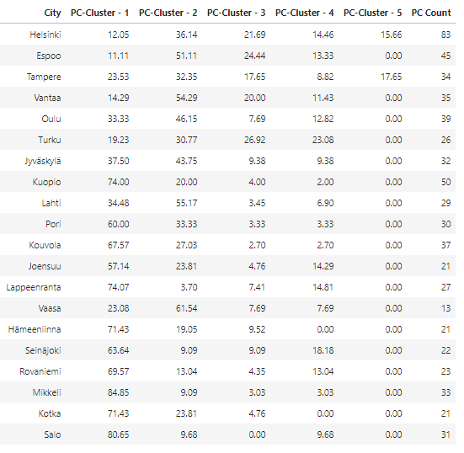
The numbers - Top 20 cities in Finland
Connection back to the Postal Code Area clusters!
Only Helsinki and Tampere have cluster 5 areas!
The smaller the city, the more cluster 1 covers it.

Slide 12
Connections between amount of cafes and other facts
(=Correlations!)

Slide 13
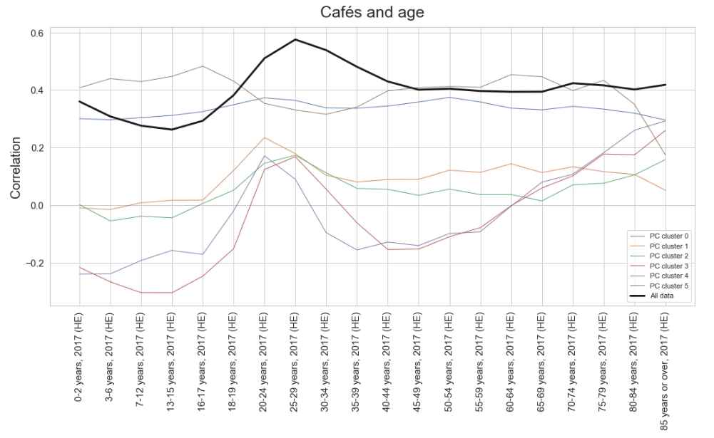
+1.0 and -1.0 tell about a strong connection, zero tells no connection can be identified
The black line tells the correlation over all postal code areas, we want to identify the high points of the black line.
Other color lines are based on smaller subsets of data (the clusters that were analyzed before), and they do not provide typically as strong correlation as the black line

Slide 14
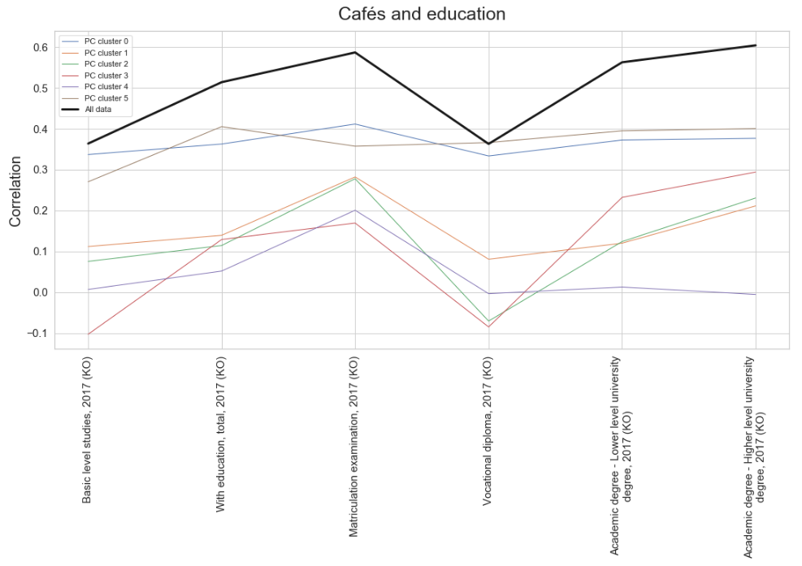

Slide 15
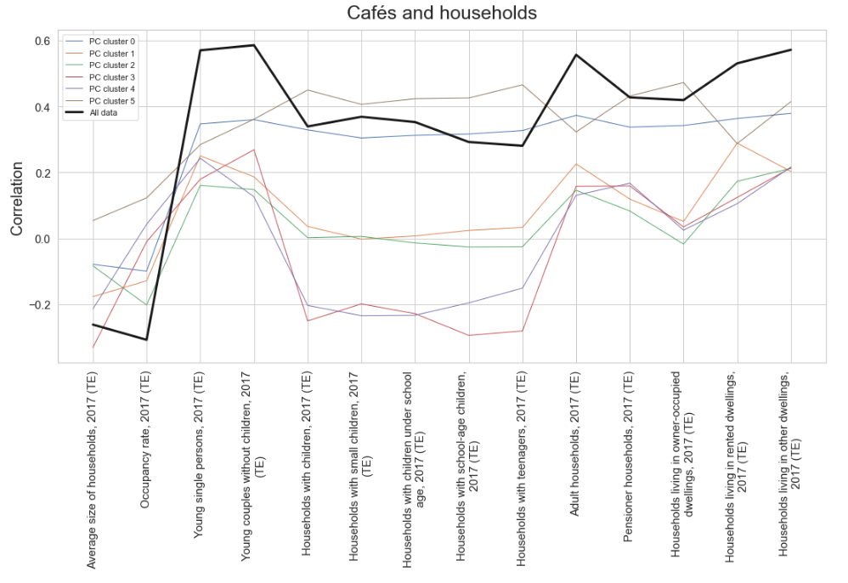

Slide 16
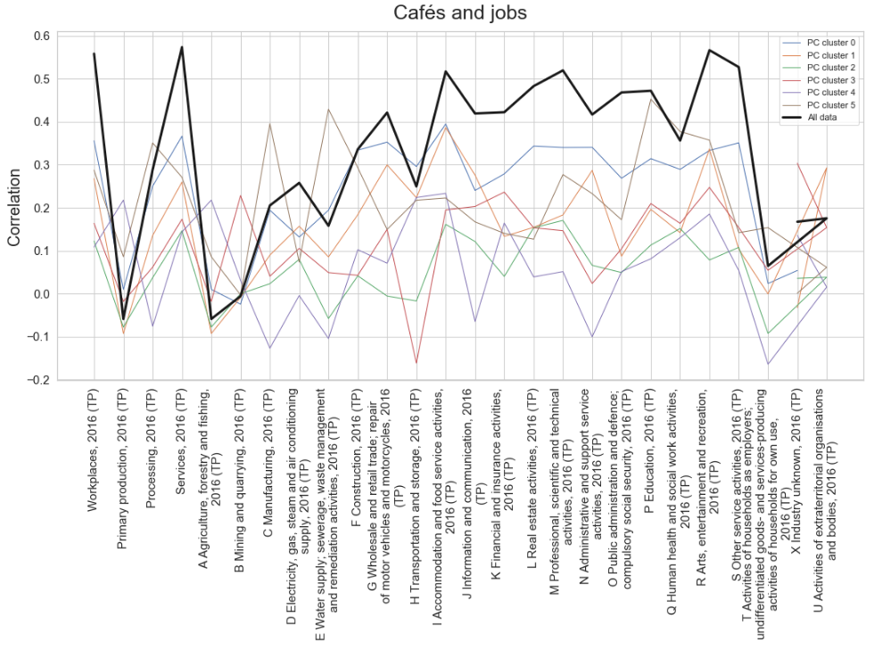

Slide 17
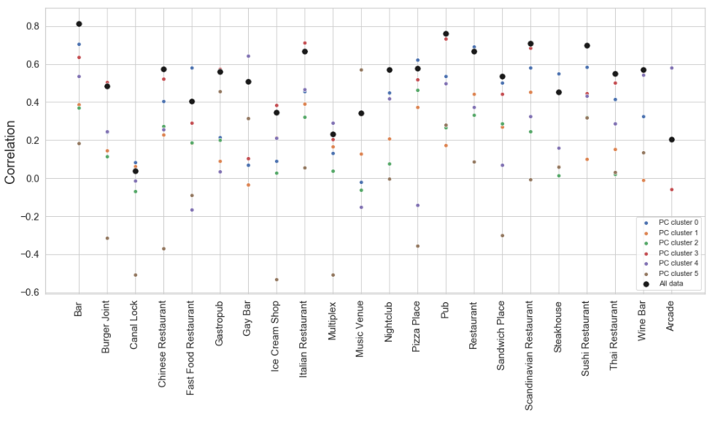
How well other venue types correlate to café amounts?

Slide 18
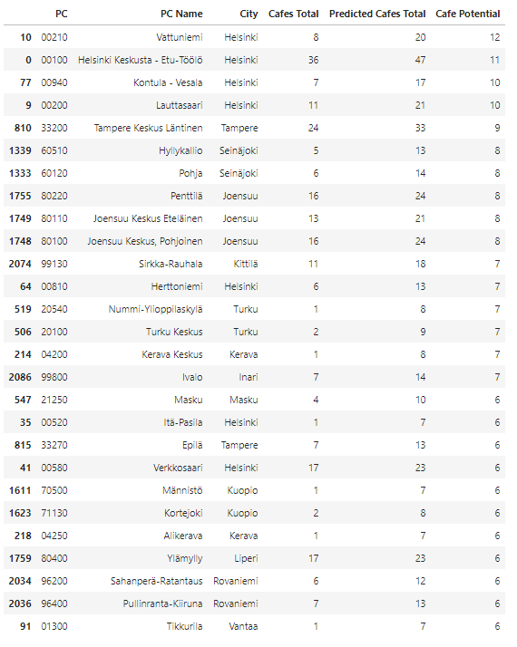
Most potential new café locations?

Slide 19
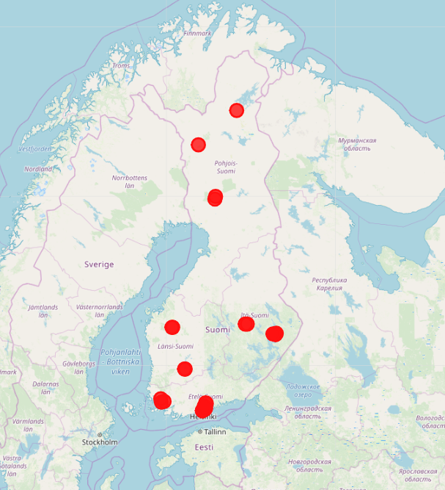
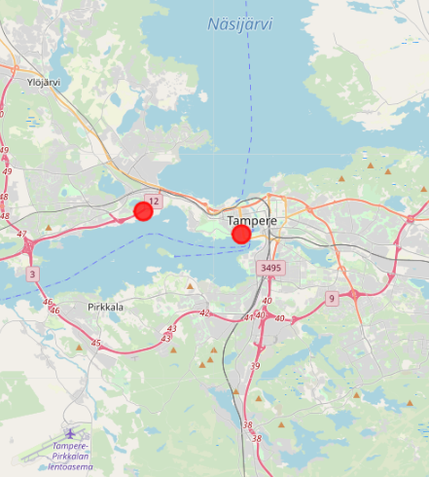
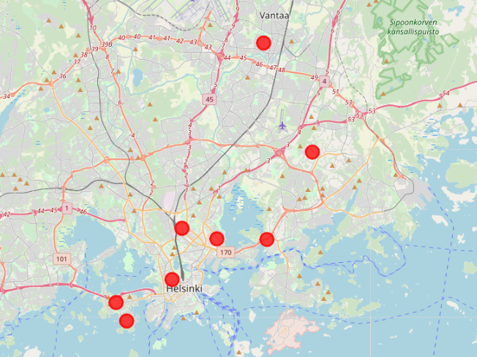
Most potential new café locations?

Slide 20
Thank you!

